Slide 1


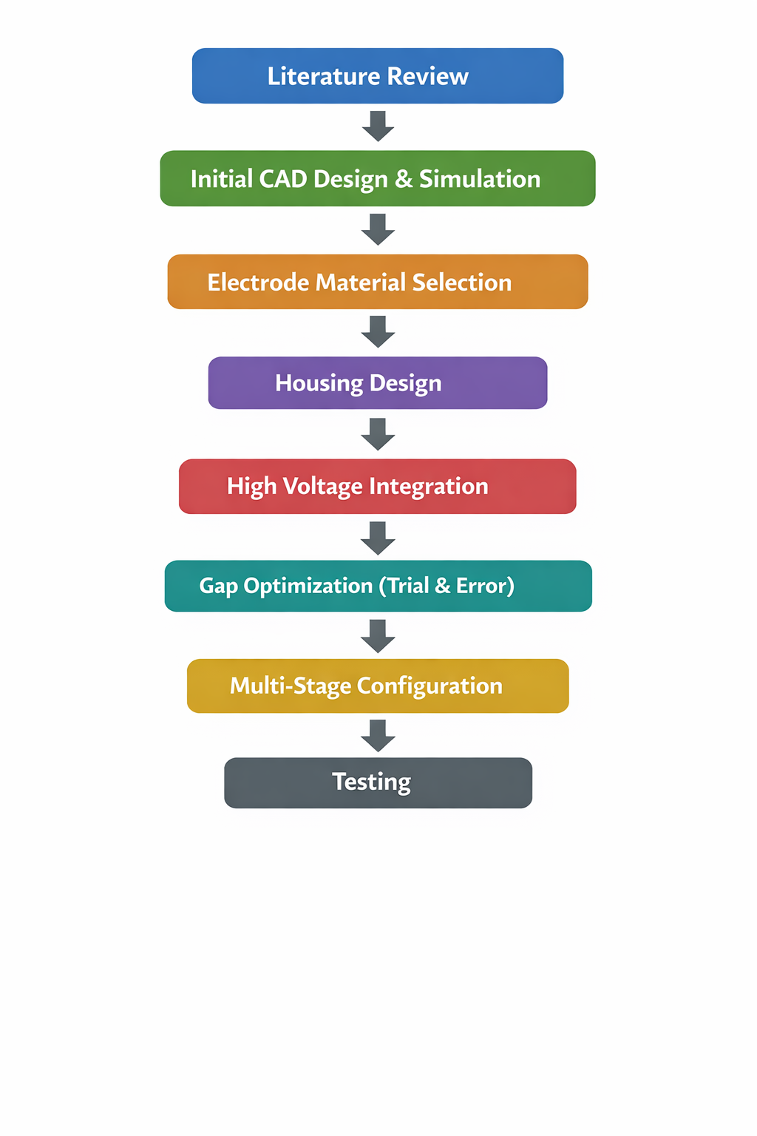
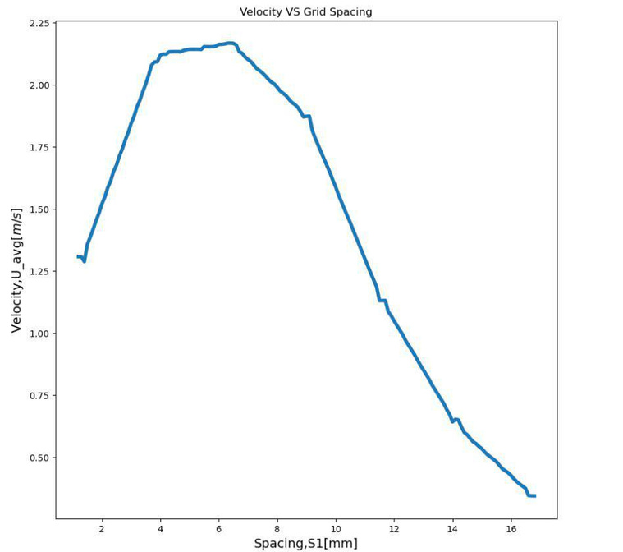
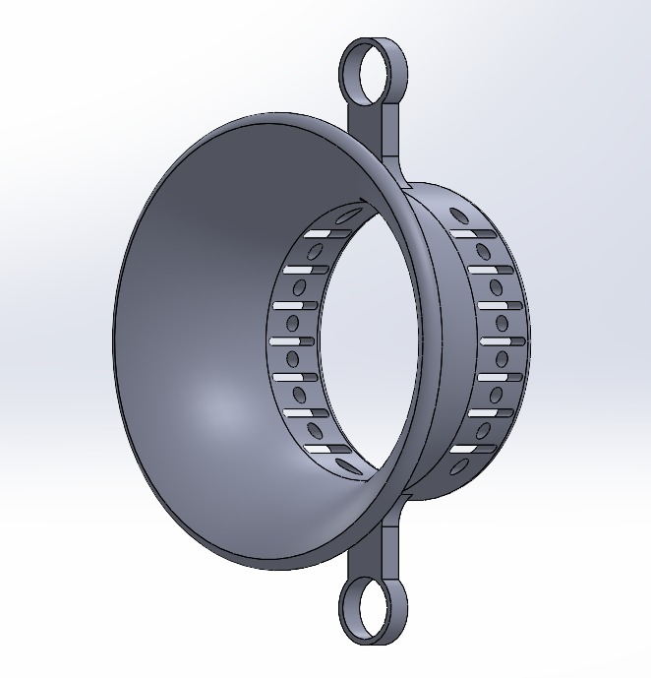
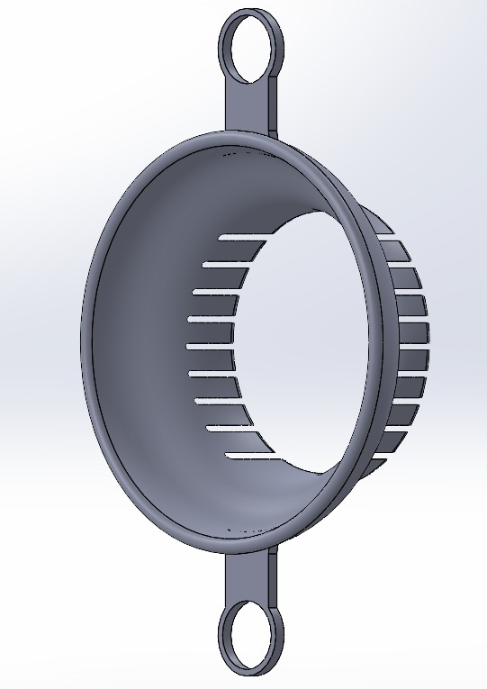
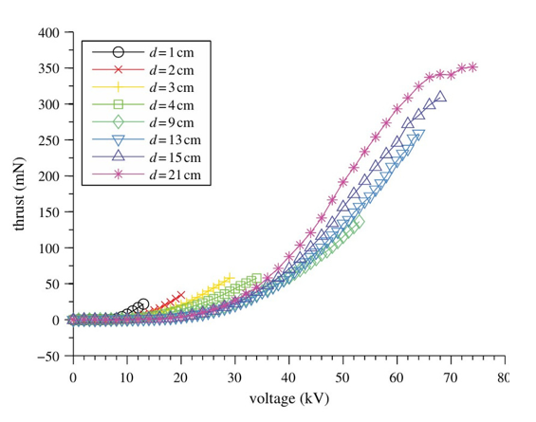
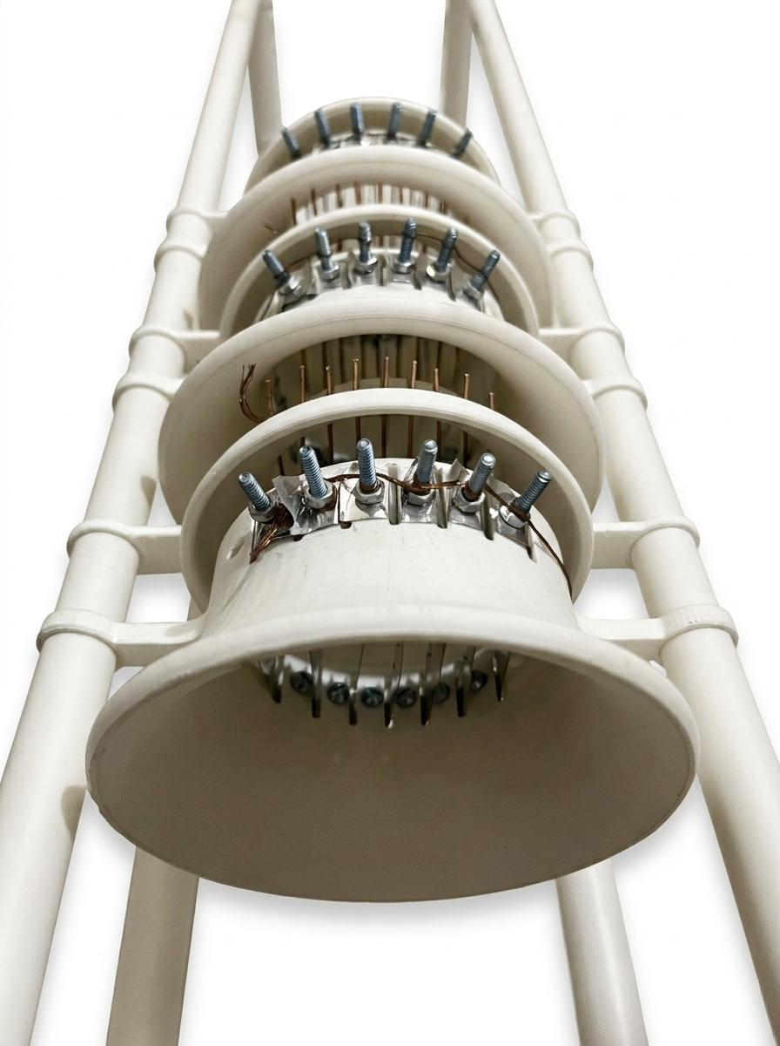
Group
B3
Forward Propulsion Using Ionic Thruster
I. J. Rahat (210011243), C. T. Al Mamun (210011214), M. Hasan (210011253), S. S. Mugdho (210011262), R.R. Adib (210011264), R. Mahmud (210011285)
Capstone Design (ME/IPE 4710) | Academic Year: 2023-24
INTRODUCTION
METHODOLOGY
RESULTS & DISCUSSION
Ionic thrusters generate thrust by accelerating charged particles using a strong electric field, a principle known as electrohydrodynamic (EHD) propulsion[1][2]. Unlike conventional propulsion systems, they have no moving mechanical parts, operate with very low noise, and can achieve high efficiency at small scales[3]. These characteristics make ionic propulsion a promising technology for lightweight aerial platforms such as gliders and micro-UAVs.
The practical development of ion propulsion was significantly advanced by NASA with the successful in-space test of the SERT-1 mission in 1964. Since then, ion thrusters have powered deep-space missions such as Deep Space 1 and Dawn, demonstrating exceptional fuel efficiency and long operational lifespan.
Motivated by the growing need for quieter and more environmentally friendly propulsion technologies, this project focuses on designing a compact laboratory-scale ionic thruster capable of generating measurable thrust. The goal is to explore its feasibility for lightweight glider propulsion and investigate the engineering challenges of adapting ion propulsion for atmospheric application
.
The ionic thruster successfully generated measurable airflow, confirming effective ionization and thrust production in the laboratory-scale prototype. Stable ionic wind was observed under optimal electrode spacing and alignment, demonstrating successful implementation of the working principle.
Occasional sparking and audible discharge were noticed during operation, indicating localized electric field concentration and minor corona instability, likely due to edge irregularities or slight misalignment. Despite this, overall airflow performance remained stable.
Although designed for approximately 40 kV operation, the actual voltage could not be consistently verified and was likely lower, limiting maximum thrust output. The step-up transformer also experienced durability issues after repeated use.
Overall, the prototype achieved reasonable thrust for its size. Future improvements should focus on precise voltage regulation, improved transformer robustness, and precision-fabricated electrodes to enhance field uniformity and reduce sparking, enabling more rigorous performance evaluation.
OBJECTIVES
Design a compact ionic thruster.
Optimize electrode geometry and spacing for maximum thrust
Fabricate a working prototype using selected materials
Experimentally evaluate thrust performance and feasibility for glider use
COMPLEX ENGG. PROBLEM
Fig 3. Velocity VS Spacing
Electrical Challenges
Reverse ion flow and charge recombination reducing thrust (WP3, WK3)
Electrical discharges and corona instability at high voltage (WP1, WK4)
Transformer and high-voltage component failures (WK6)
Corona losses reducing propulsion efficiency (WP2)
Flow & Performance Challenges
Non-uniform ion distribution affecting thrust generation (WP3, WK2)
Instability in ion flow behavior under atmospheric conditions (WP4)
Limited thrust-to-power ratio requiring optimization (WP1)
Mechanical & Structural Challenges
Precision electrode alignment required for stable electric field (WP7)
Lightweight yet electrically insulated structure design (WP2, WK5)
Engineering Activities (EA)
Integration of high-voltage system, electrode design, and structural housing (EA1, EA2)
Experimental optimization of electrode spacing and multi-stage configuration (EA3)
Prototype testing and performance evaluation of ionic propulsion (EA5)
Fig 1 . CAD design
Fig 4 . Thrust VS Voltage
REFERENCES
D. M. Goebel, I. Katz, and I. G. Mikellides, Fundamentals of Electric Propulsion, 2nd ed. Hoboken, NJ, USA: Wiley, 2023.
V. Y. Khomich, V. E. Malanichev, and I. E. Rebrov, “Electrohydrodynamic thruster for near-space applications,” Acta Astronautica, vol. 180, pp. 141–148, 2021, doi: 10.1016/j.actaastro.2020.12.002.
E. Stuhlinger, Ion Propulsion for Space Flight. New York, NY, USA: McGraw-Hill, 1964
Fig 2 . Final Setup
DEPARTMENT OF MECHANICAL AND PRODUCTION ENGINEERING
ISLAMIC UNIVERSITY OF TECHNOLOGY (IUT)
Notes:
Write your name in short form ( e.g. Abu Bakar Siddiqui > A. B. Siddiqui).
Maintain the given font type and sizes.
Add figure caption in italic (Fig 1. Schematic Diagram of ……..) below the figure with middle alignment.
Add table caption in italic (Table 1. List of ……..) above the table with middle alignment.
Introduction: Describe the research background with proper references. Follow IEEE reference style.
Complex Engg. Problem:
Methodology: Describe briefly the methodology of the project with proper figures and diagrams of CAD model and final product
Result & Discussion: Discuss briefly the performance/evaluation of the fabricated model with necessary figures
References: Name of the first author only, abbreviated journal name, year of publication: volume(issue).

